Slide 1
Inheritance: Abstract Classes
Module 1: 13

Slide 2
Objectives
Final Methods and Classes
Abstract Methods Classes
Protected and Default

Slide 3
Final Methods and Classes
The final modifier can be used with methods and classes to control how they are used.
A final method cannot be Overridden.
public final String myMethod(){ }
A final Class cannot have subclasses.
public final class myClass { }

Slide 4
Abstract Class
An abstract class cannot be instantiated and exists solely for the purpose of inheritance and polymorphism.
Like a combination of an interface and a superclass.
Can extend it like a superclass
Can inherit implementation from it like a superclass
Can provide method signatures that must be implemented like an interface
A class can only extend either 1 abstract class or 1 superclass, but may implement multiple interfaces.

Slide 5
Abstract Method
A method signature with the abstract modifier. Can only exists in an abstract class, and must be overridden in any implementation class that extends the abstract class.
public abstract int doSciene(int x, int y)

Slide 6
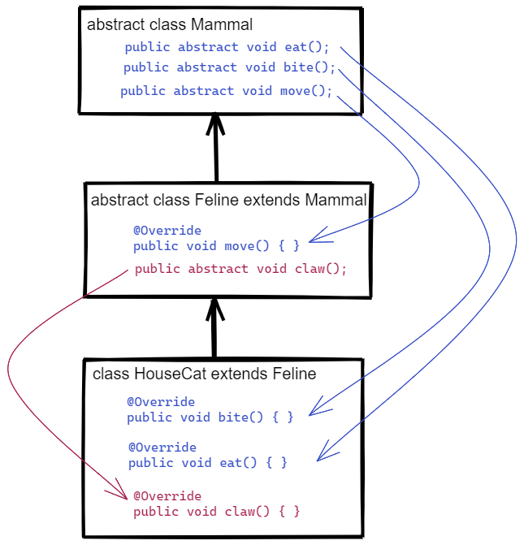
Abstract Method Transitivity
If an abstract class extends another abstract class, then it can choose to implement the abstract method or do nothing and pass it on to the class that extends it.
All abstract methods must have implementation by the time extended by the first concrete implementation class.

Slide 7
Superclass vs Interface vs Abstract
An interface provides method signatures without implementation that creates a contract of what must have a subclass specific implementation. Can represent either an HAS-A or IS-A relationship.
A superclass provides default implementation that can be inherited by a subclass, so it can guarantee a default implementation, but not a subclass specific one. Can only represent an IS-A relationship.
An abstract class allows for default implementation to be inherited and/or to provide method signatures for methods that must have a subclass specific implementation. Can only represent an IS-A relationship.

Slide 8


 | Passes on implementation | Forces Override | Can be instantiated | IS-A | HAS-A | extends | implements | Subclass can have multiple | Defines a Data Type
Superclass
Interface
Abstract class
Common Interview Question
What is the difference between an interface and an abstract class?

Slide 9
Reasons to use an Abstract Class
To prevent a superclass from being instantiated.
For example: Having a Generic “Feline” as an object may not make sense, so by making Feline abstract it forces the user of the class to instantiate the more concrete HouseCat or Lion objects that are subclasses of Feline.
When you need to have the ability to inherit functionality from a superclass and force a subclass to implement subclass specific methods.
Abstract classes should only represent a IS-A relationship (a Car IS-A Vehicle) and never a HAS-A relationship (a Car HAS-A Drivable)
This same need can also be accomplished by using a combination of a superclass and interfaces.

Slide 10
Protected and Default Access Modifiers
Private - accessible on in the class
can be applied to methods and member variables
Protected - accessible in the class and in any subclasses in the inheritance tree.
can be applied to methods and member variables
In Java, Protected it also available to any class in the same package, but this use is discouraged.
Default (no access modifier) - accessible to any class or subclass in the same package.
can be applied to methods and member variables
Public - accessible everywhere
can be applied to methods, member variables, classes, and interfaces)
Java Accessors Cheatsheet

Slide 11
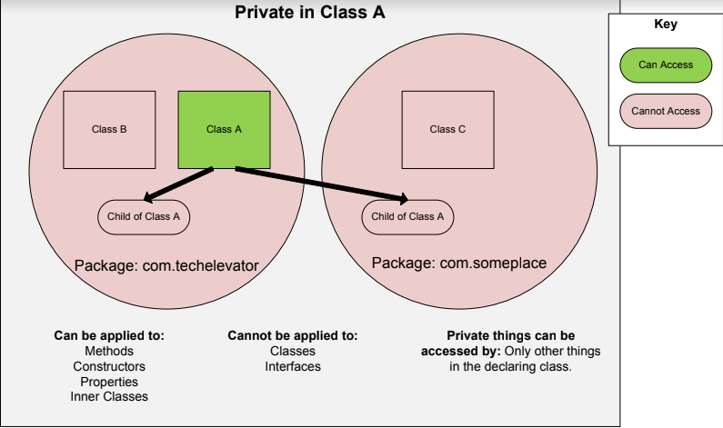

Slide 12
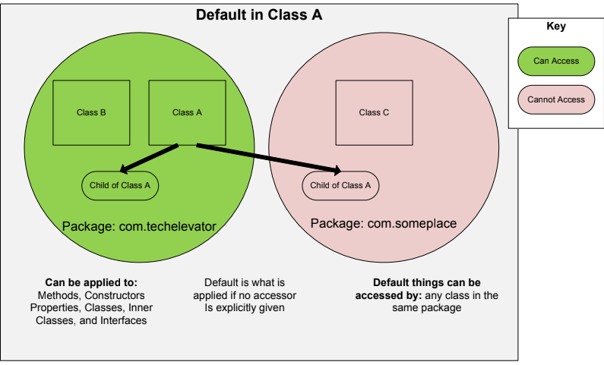

Slide 13
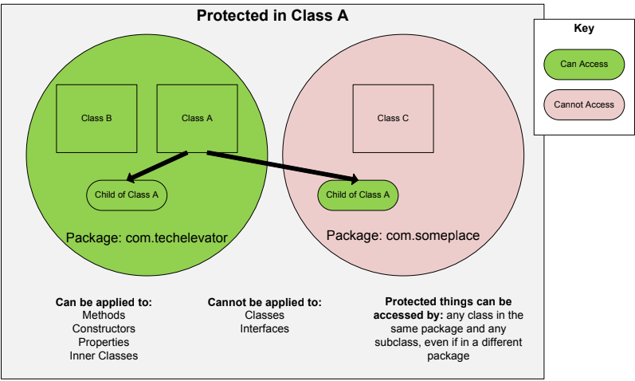

Slide 14
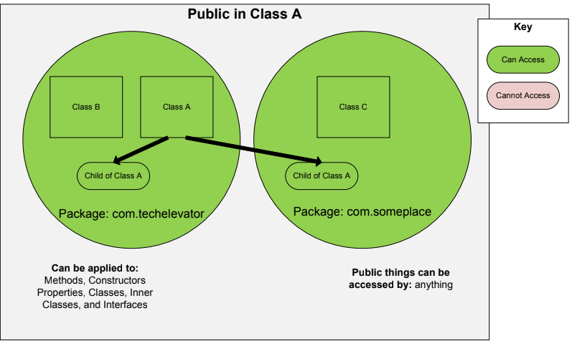

Slide 15
When to use each accessor
Public is for “set in stone” methods that you want other programmers to rely on to use your object. These create the behaviors of the object, but changing their method signatures may break other code that is using your object.
Protected is for building connections between inherited classes. It lets you have methods in a superclass that are accessible to the subclasses, but does not allow access outside the hierarchy.
Private is for unstable, worker methods that may change and are only for use inside the class itself.
Default should generally be avoided.
Class design should include how others will use your object, the methods that allow that use should be public. All other methods and variables should be private, until needed in the hierarchy or publically. So if you are unsure, start as private and increase the access as needed.

